Slide 1
ICT Enabled Public Services for Migration
Dr Karen Latricia Hough and Professor Petra Saskia Bayerl
CENTRIC
Co-creating ICT enabled public services for migration: from challenges to solutions
26th January 2022 Final conference for the H2020 MIICT project

Slide 2
Co-creation – strength based approach
Co-creation -empowers migrants, including asylum seekers and refugees by enabling them to co-design the ICT solutions with public service providers and representatives from NGOs that will enable them to get access to vital services and information, helping them to integrate
Offers a “bottom-up” approach to integration
This is essential, since current research shows that migrants experience poverty, marginalisation and even abuse whilst living in the EU (Belloni, 2016; Esson, 2015; Innes, 2016; Kuschminder, 2018; Ossipow, Counilh & Chimienti, 2019; Pogliano, 2016; Patterson and Leurs, 2019; Tuckett, 2016; Sawert, 2019)
Technology is crucial for migrants (Dhoest, 2020; Fiedler, 2019; Gillespie et al., 2018). The Internet and mobile connectivity can improve refugee well-being and transform humanitarian action,” (UNHCR, Geneva, June 2016)

Slide 3
Barriers to migrant integration
Digital connectivity is perceived as being interwoven into all aspects of the migration journey, affecting migrants’ experience pre-entry and post arrival (Diminescu & Loveluck, 2014)
Rise in Xenophobia – need to focus on the importance of migrants’ economic contribution and involve members of the host society in the co-creation process
Need for integration from Day 1 – learning the language, verification of qualifications, create a CV, job matching tools
Digital litter (Benton, 2019) ghost websites and outdated information leads migrants to rely on informal sources i.e., smugglers, thus exposing them to increased risks

Slide 4
MIICT - Co-creation Methodology
INSPIRATION
Understanding the people we are designing for;
what they want
their hopes, their needs.
IDEATION
Making sense of the information inspiring us,
generating ideas,
designing opportunities,
prototyping ideas and working towards solutions
IMPLEMENTATION
Building our solution,
testing and refining in the real world
learning to maximise its impact
Notes:
So our methodology broadly takes place in three phases:
INSPIRATION
IDEATION
And IMPLEMENTATION.
We want to get inspired:
Understand the people and the problem we are designing for
understand what they want
What they need… and what they hope for
Based on that, hopefully, we are going to put our creative brains to work
Make sense of the information that has inspired us and generate a tonne of ideas
Opportunities for the design and development of new services, and the re-working of existing services
Then build prototypes and work towards feasible solutions.
Then we’re going pick the most viable, most appropriate prototypes and work towards a solution.
We’re going to test and refine in the real world. Using our pilot studies.
And hopefully maximize its impact.

Slide 5
Co-creating ICTs
Workshops were conducted in the pilot countries of Cyprus, Italy and Spain
Researchers used visual techniques e.g., drawings, storyboards and mind maps to add emotional and affective dimensions
Sensitive topics need to be addressed in certain ways to give migrants the possibility of being active in directing the research, and reduce emotional stress
Iterative approaches – researchers obtained feedback from the participants at all stages of the research
Participant as a co-researcher – the same participants were involved in the research where possible

Slide 6
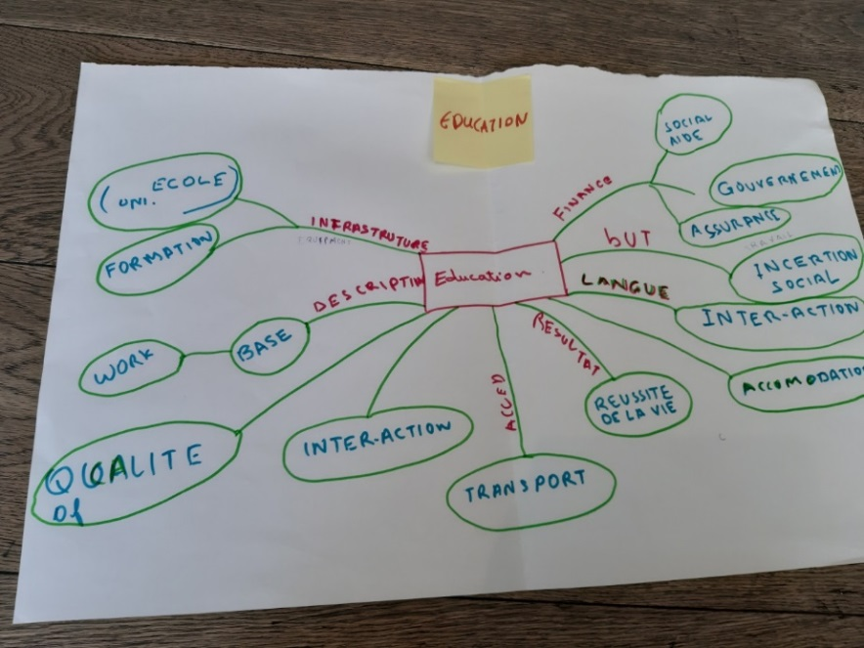
Inspiration Aim: Eliciting Challenges
Traditional methods
Case studies
In-depth interviews
Online questionnaire
Focus Groups discussions
Co-Creation Workshops
29 mind maps
23 story boards
Reflecting current challenges
Notes:
Mind mapping enable us to tackle the issue of "socially desirable responses“ and vulnerable participants who have often suffered exploitation, trauma and/or abuse
Prototyping: 13 mock-ups were introduced to our target group users (participatory design)

Slide 7
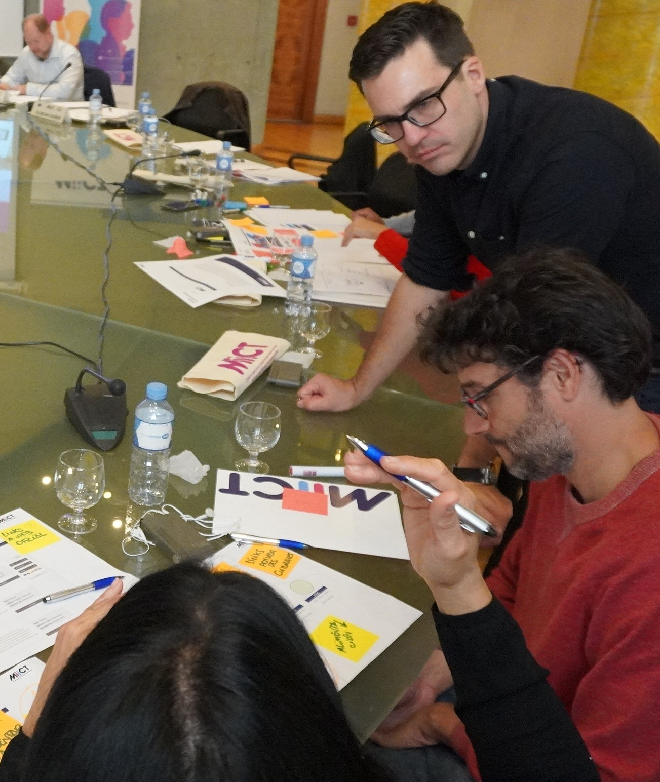
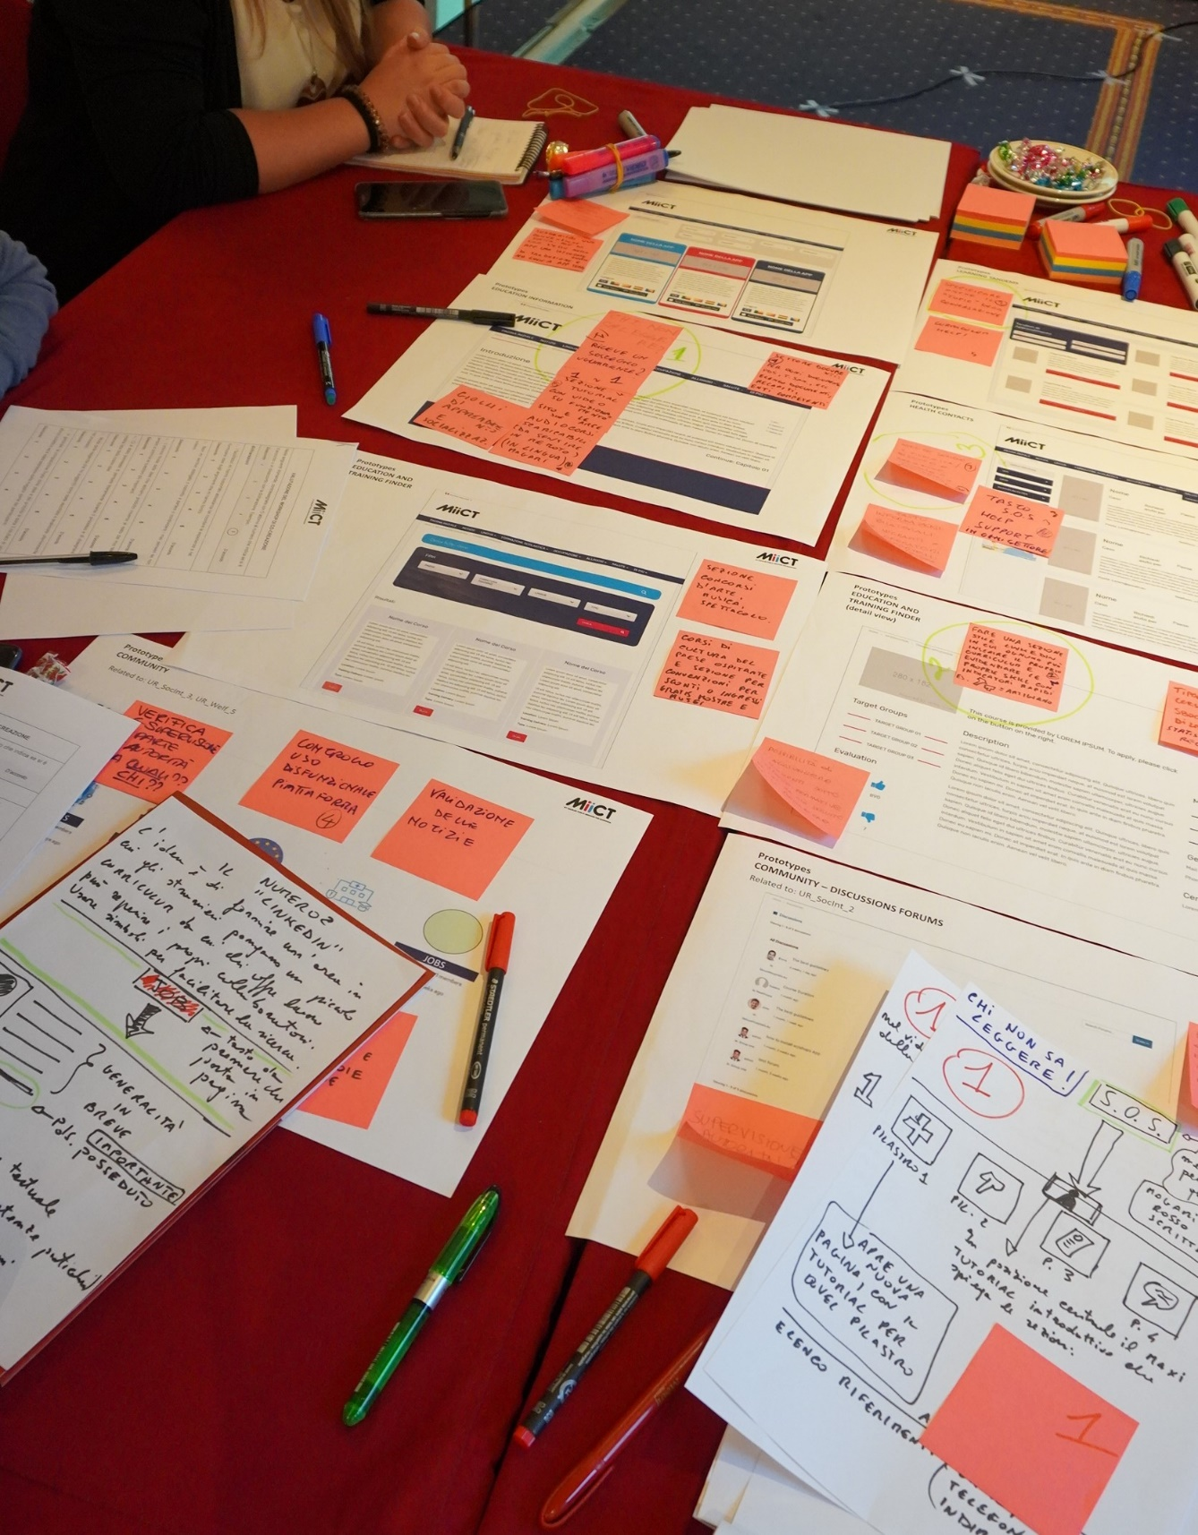
Solutions
Mixed groups -design the platform and create solutions helping migrants to integrate
Empowerment of migrants
Testing of the platform in a 6- month SSD phase
“real life”

Slide 8
Challenges
Co-creation methods produce rich data that can be difficult to interpret
Ethical concerns – certain services could not be included i.e., house and car sharing
Digital literacy - Digital divide (Alam & Imran, 2015) may occur on grounds such as educational level, language skills, gender, age, previous exposure to digital devices, and income (Farbenblum, Berg & Kintominas, 2018) – need for digital training courses to be built into the platform and provided in the community. Some service providers were not tech savvy and did not have up to date systems.
Some migrants do not have access to devices and WIFI is costly – Need for Free Wi-Fi, access via hubs in NGOs and libraries

Slide 9
Barriers
Fears of digital surveillance (Dekker et al., 2016; Gillespie et al., 2018).– migrants fear registering their emails – need offline content and privacy legislation to be built into the system in a simple format in multiple languages reassuring migrants their data will be kept private
Circulation of (mis)(dis)information – create stakeholder groups with migrants in order to undertake platform maintenance to vet all links and ensure reliability, credibility, protection
Policy recommendations - Co-creation in policy making labs - UK, EC expert committees
Need to co-create information campaigns to ensure platform uptake and reach hidden groups

Slide 10
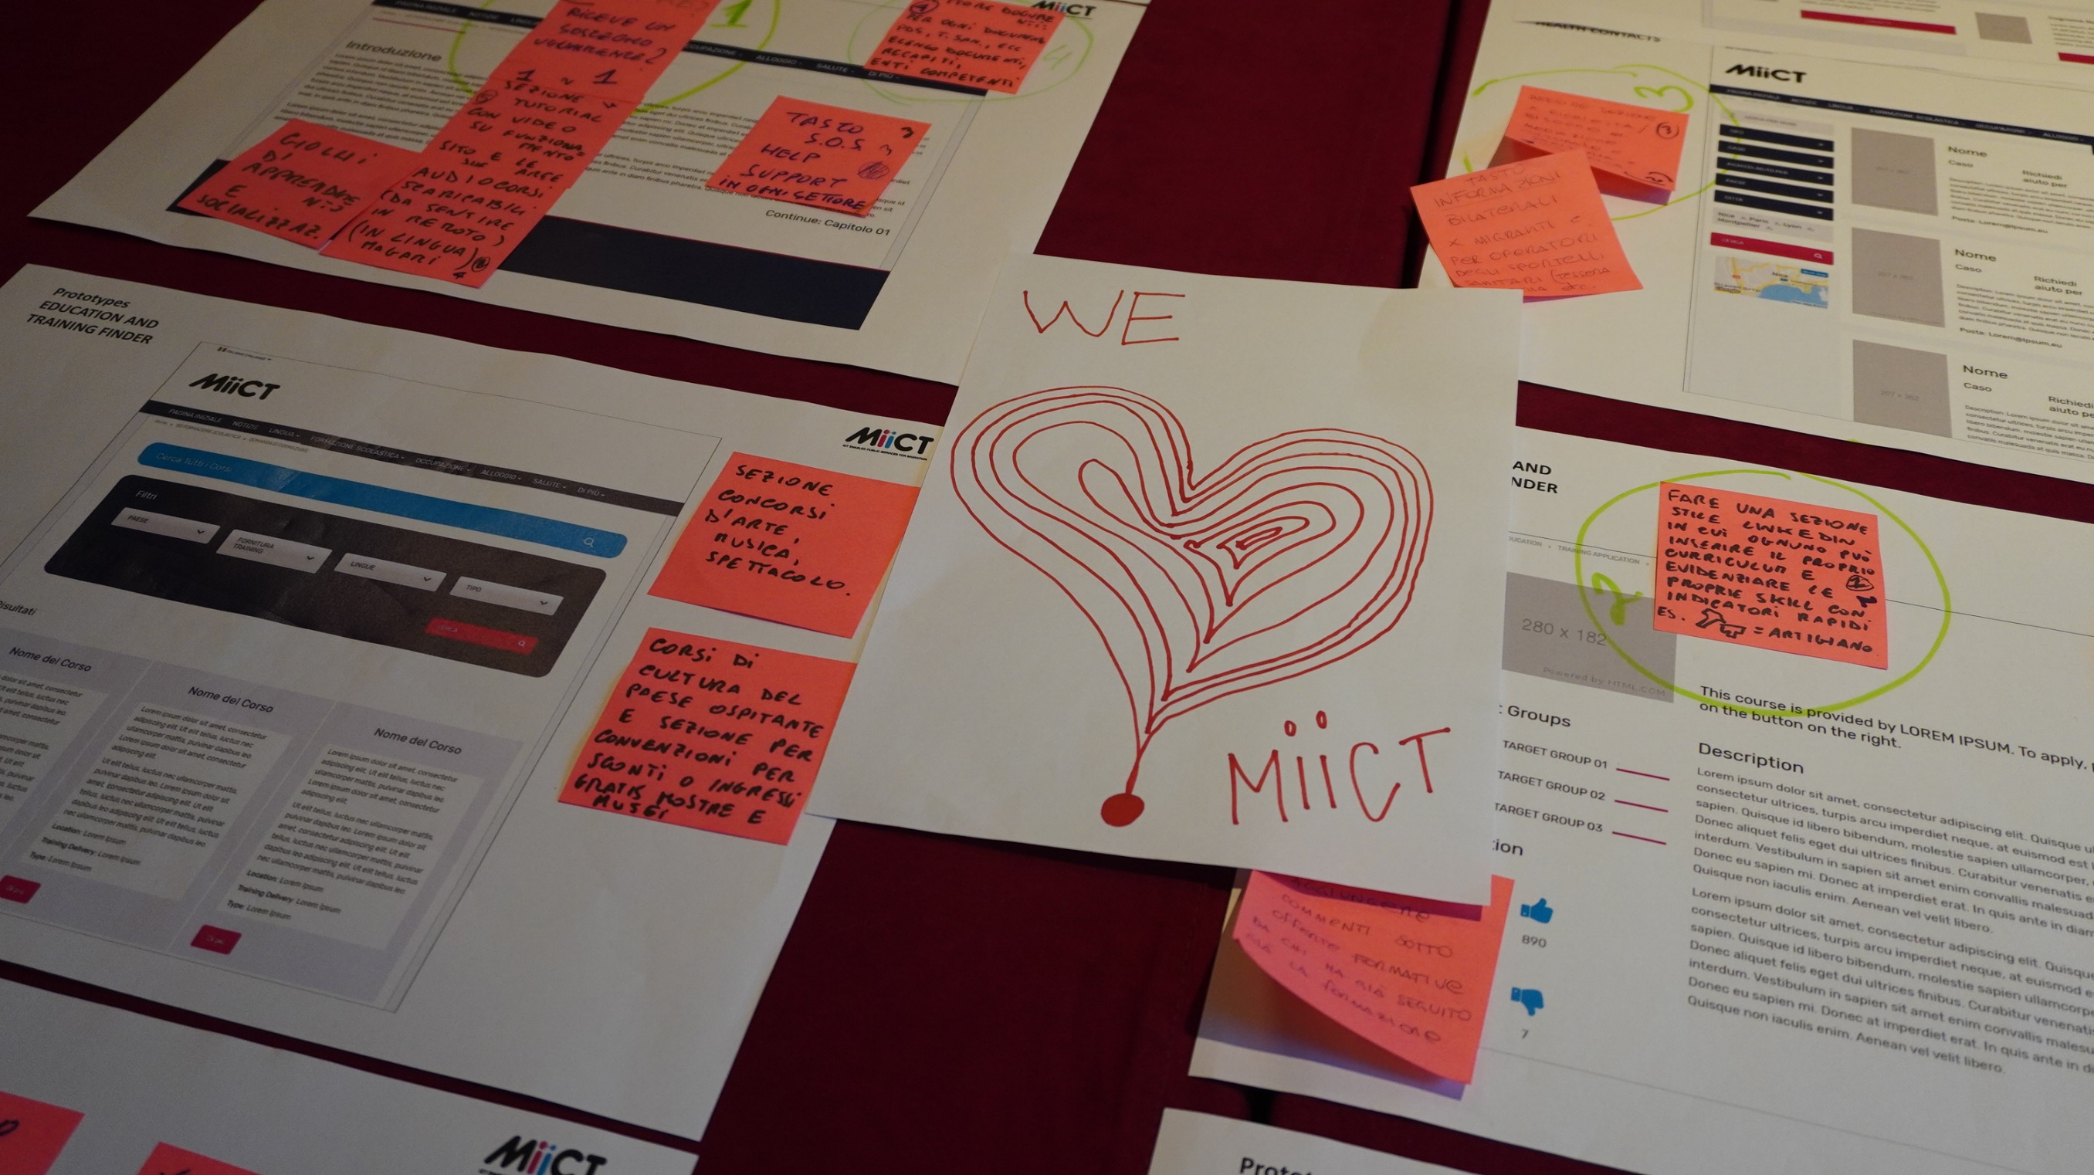
Recommendations – Co-design for public service handbook
Involve representatives from host society and technical developers in the co-creation workshops
Complement co-creation methodology with traditional methods
Ethics and data protection protocols
Translations - be sensitive to dialects
Creation of a SECC committee – avoid researcher bias

Slide 11
References
Alam, K., & Imran, S. (2015). The digital divide and social inclusion amongst refugee migrants: A case in regional Australia. Information Technology & People, 28(2) 344-365.
Belloni, M. (2016). Refugees as Gamblers: Eritreans Seeking to Migrate Through Italy. Journal of Immigrant & Refugee Studies, 14(1) 104-119.
Benton, M. (2019) Digital Litter: the downside to using technology to help refugees. Migration Policy Institute. https://www.migrationpolicy.org/article/digital-litter-downside-using-technology-help-refugees
Dekker, R., Engbersen, G., & Faber, M. (2016). The use of online media in migration networks. Population, Place and Space, 22(6) 539–551.
Diminescu, D., & Loveluck. B. (2014). Traces of dispersion. Online media and diasporic identities. Crossings: Journal of Migration & Culture, Intellect, 5(1) 23-39.
Dhoest, A. (2019). Digital (dis)connectivity in fraught contexts: The case of gay refugees in Belgium. European Journal of Cultural Studies 1 –17. DOI: 10.1177/1367549419869348.
Esson, J. (2015). Better Off at Home? Rethinking Responses to Trafficked West African Footballers in Europe. Journal of Ethnic and Migration Studies, 41(3) 512-530.

Slide 12
References
Farbenblum, B., Berg, L. and Kintominas, A. (2018). Transformative Technology for Migrant Workers: Opportunities, Challenges, and Risks. New York: Open Society Foundations.
Fiedler, A. (2019). The gap between here and there: Communication and information processes in the migration context of Syrian and Iraqi refugees on their way to Germany. The International Communication Gazette, 81(4) 327–345.
Gillespie, M., Osseiran, S., & Cheesman, M. (2018). Syrian Refugees and the Digital Passage to Europe: Smartphone Infrastructures and Affordances. Social Media & Society 1-12.
Innes, A.J. (2016). In Search of Security: Migrant Agency, Narrative, and Performativity. Geopolitics, 21(2) 263-283.
UNHCR, Geneva, June 2016, https://www.unhcr.org/innovation/wp- content/uploads/2018/02/20160707- Connecting-Refugees-Web_with-signature.pdf
Kuschminder, K. (2018). Afghan Refugee Journeys: Onwards Migration Decision-Making in Greece and Turkey. Journal of Refugee Studies, 31(4) 566-587.

Slide 13
References
Ossipow, L., Counilh, A.L., & Chimienti, M. (2019). Racialization in Switzerland: experiences of children of refugees from Kurdish, Tamil, and Vietnamese backgrounds. Comparative Migration Studies, 7(19).
Patterson, J., & Leurs, K. (2019). ‘We Live Here, and We Are Queer!’ Young Adult Gay Connected Migrants’ Transnational Ties and Integration in the Netherlands. Media and Communication, 7(1) 90-101.
Pogliano, A. (2016). News Media and Immigration in the EU: Where and How the Local Dimension Matters. In Pastore, F. & Ponzo, I. (eds.). Inter-group Relations and Migrant Integration in European Cities. IMISCOE Research series. Springer, Cham.
Sawert, T. (2020). Understanding the mechanisms of ethnic discrimination: a field experiment on discrimination against Turks, Syrians and Americans in the Berlin shared housing market. Journal of Ethnic and Migration Studies, 46(19), 3937-3954.
Tuckett, A. (2016). Moving on: Italy as a steppingstone in migrants’ imaginaries. Focaal, Journal of Global and Historical Anthropology (76). LSE online.

