Slide 2
MIICT FINAL CONFERENCE 26 th January 2022
“Supporting migrants through ICTs in Spain.
The main findings from the MIICT project”
Patricia Bueso
Euro-Arab Foundation for Higher Studies (FUNDEA)

Slide 3
What these ICT solutions means for migrants, asylum seekers and refugees and key social service providers?

Slide 4
SPAIN
Migrants from different countries: Colombia, Venezuela, Morocco, Yemen, Sierra Leone, Russia, Honduras, Peru, El Salvador, Pakistan, Lybia...
NGOs/Service Providers/SME from different organizations experts in the field of migration, working with asylum seekers, refugees, migrants and minor non unaccompanied

Slide 5
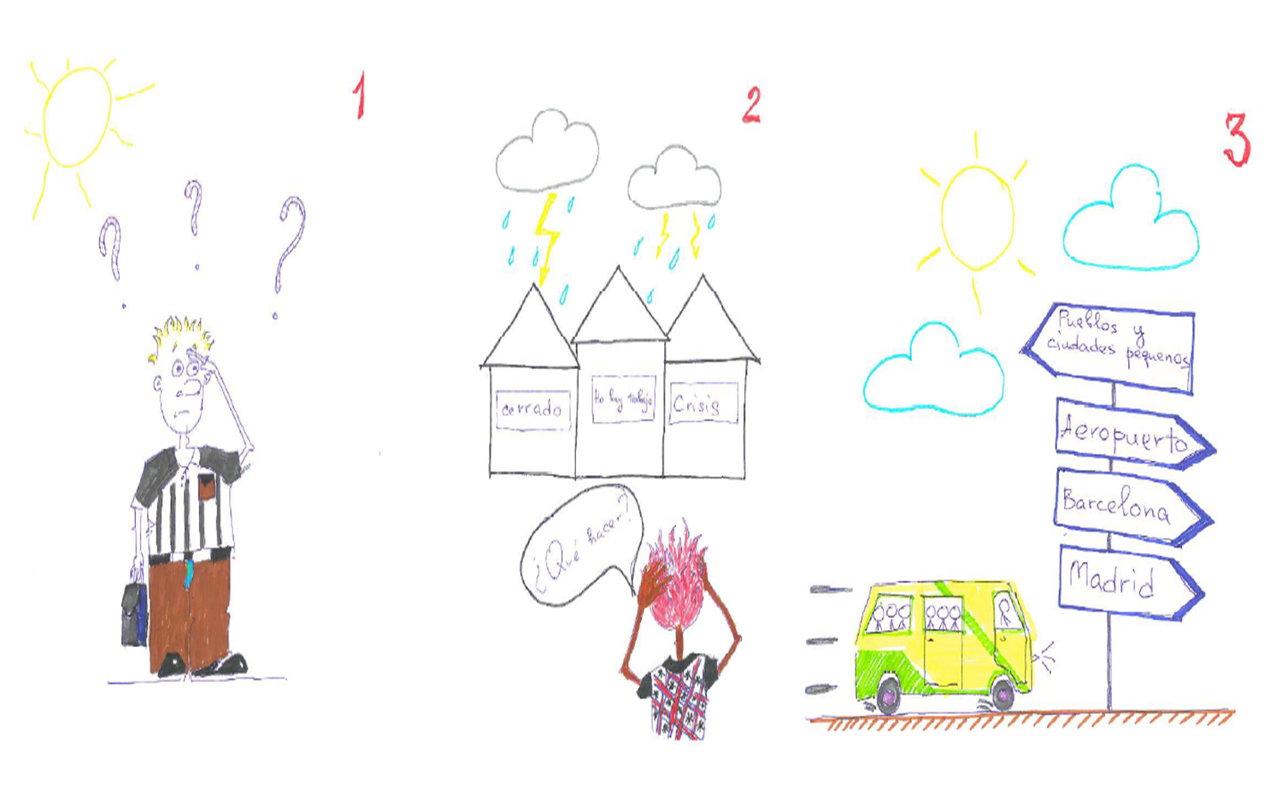
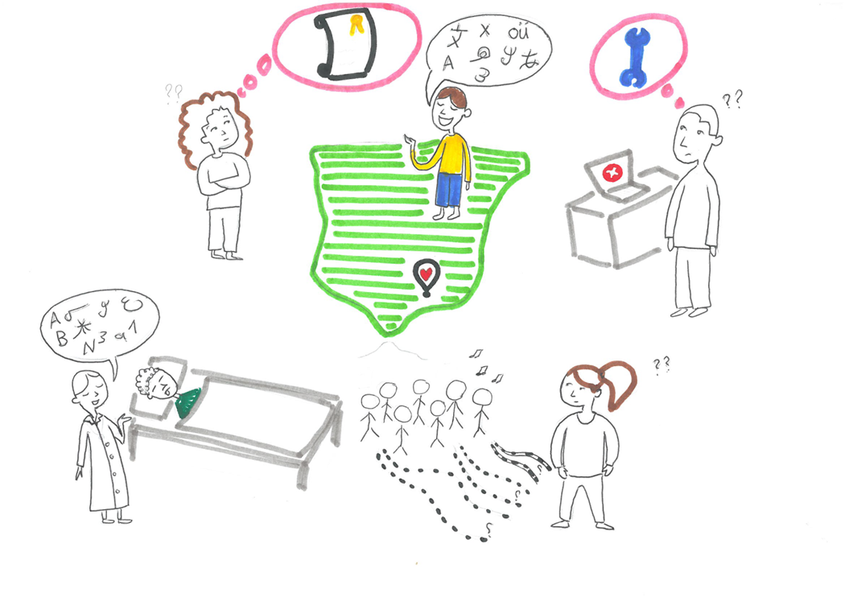
Methodology in practice Co-Creation Workshops
Storyboards

Slide 6
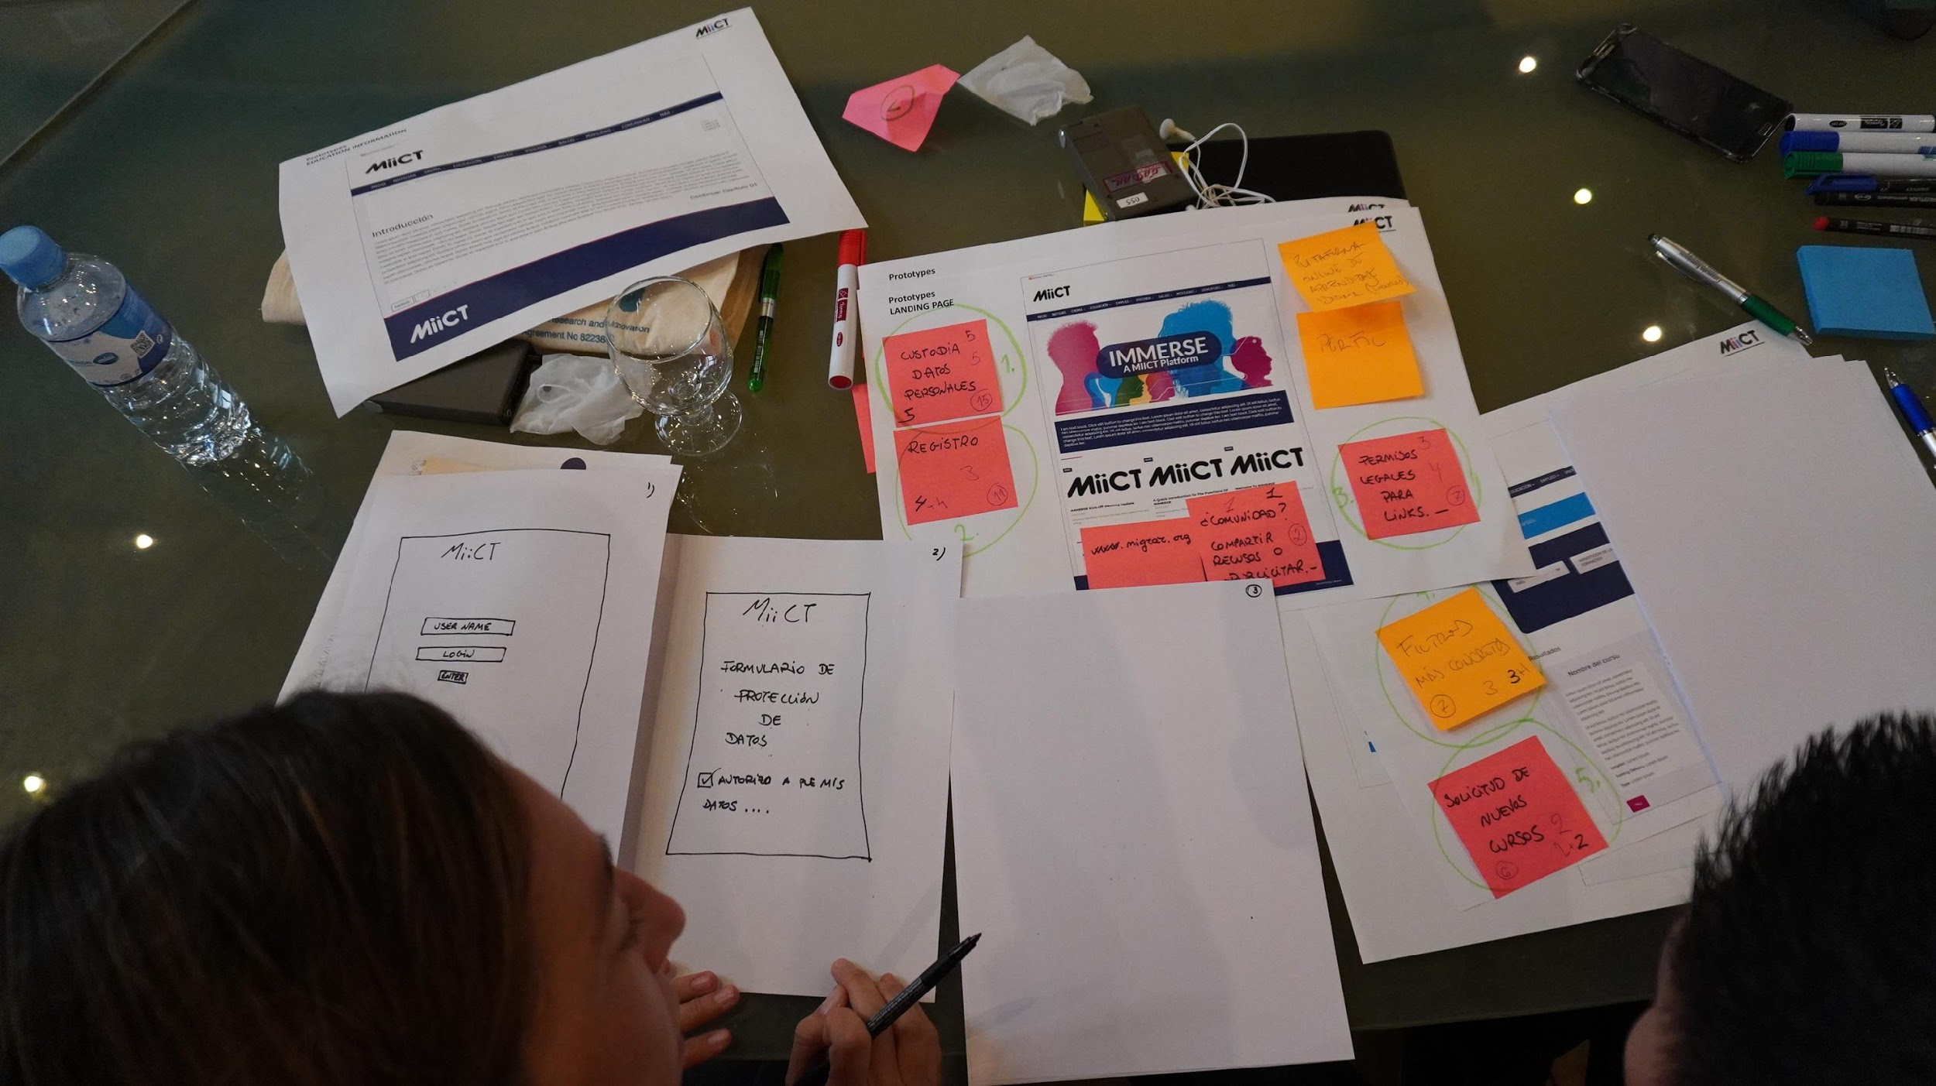
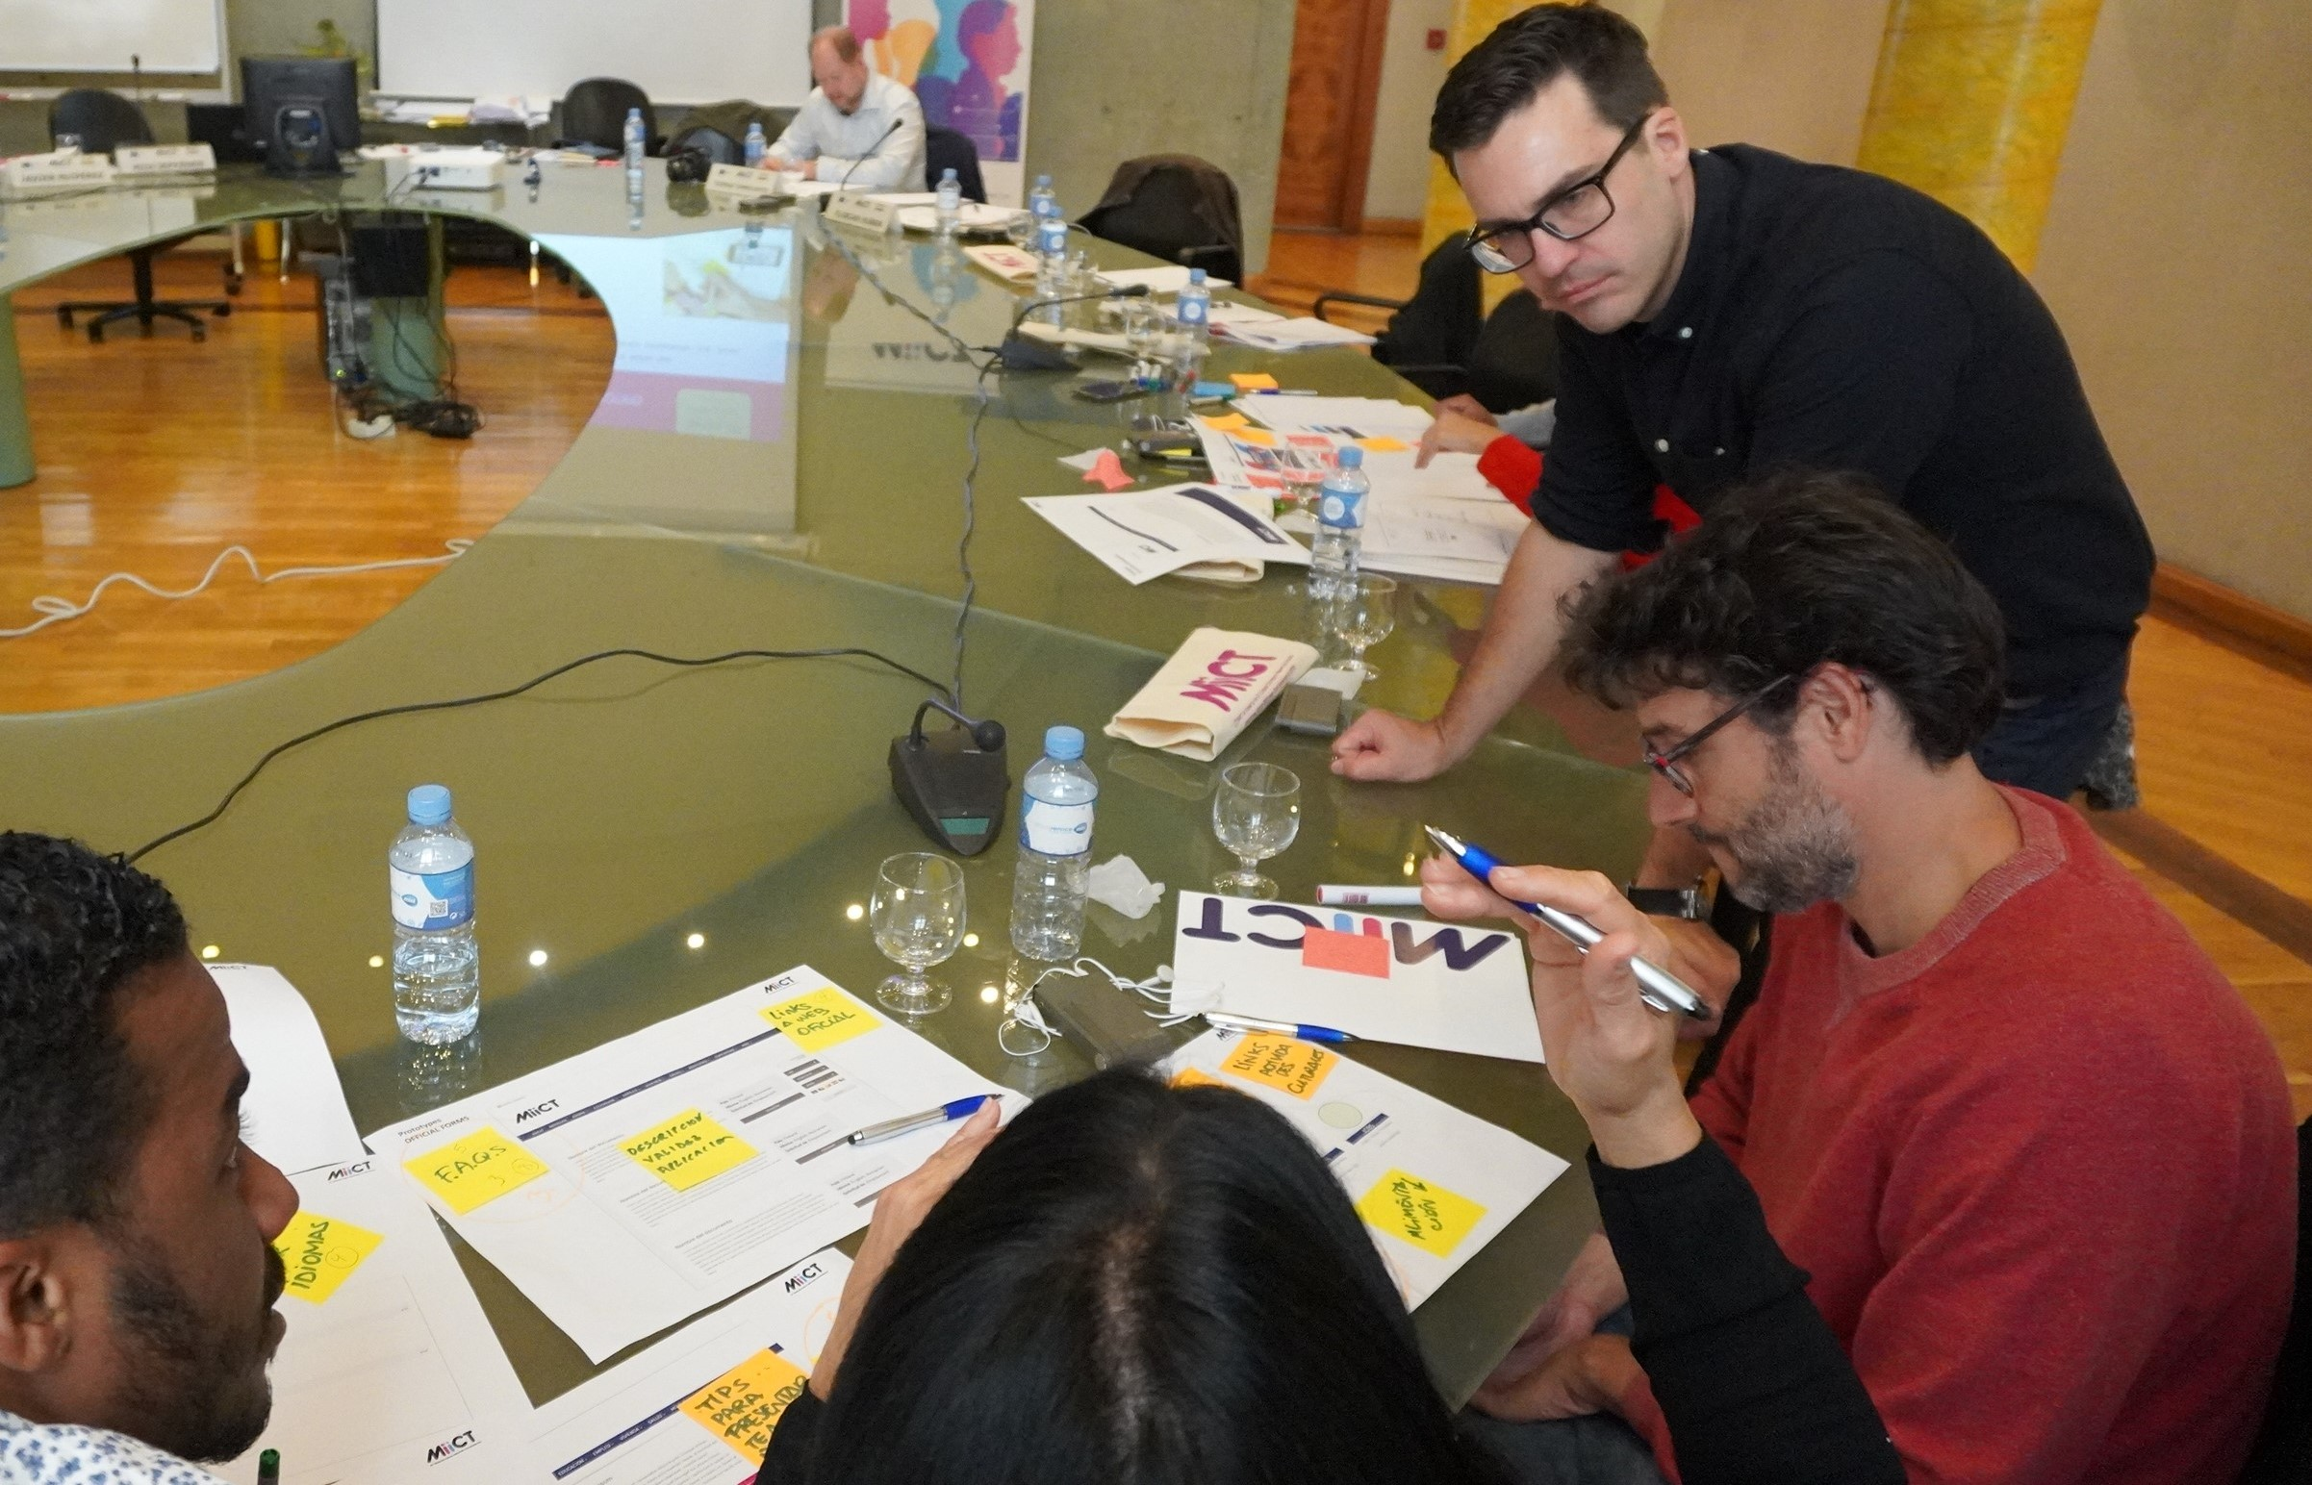
Participatory Design

Slide 7
Some preliminary results
Identified 9 challenges (pillars) for migrant integration and proposed functions for each of the 9 pillars identified divided into informational and transactional services
Status
Language
Education
Accommodation (Housing)
Employment
Social Security
Transportation (Mobility)
Health
Social Integration

Slide 8
Sustained Service Delivery
Testing IMMERSE platform with real data, posting offers in different services and reviewing informational pillars, evaluating it usability by target groups (migrants, refugees and asylum seekers, service providers, NGOs and subject matter experts)

Slide 9
What were the challenges?
Achieve real interaction among participants through the platform

Slide 10
Enrich IMMERSE with adapted services for migrant people with disabilities or learning difficulties

Slide 11
Keep up the motivation of all participants during the project

Slide 12
Platform was not so intuitive both for skilled computer users and those with limited computer skills at the first moment

Slide 13
Solve some error translations on IMMERSE services

Slide 14
Improve access for hand-held devices

Slide 15
What did the participants share with us about ICTs as IMMERSE?
(M) Do you think that the IMMERSE platform is enhancing your learning capabilities?
I totally agree, every time you get more involved in the platform you learn more, every time you open a section you discover something else that can be useful to you, you have to get very involved for that.
You can also improve your digital competences, because you have to learn how to use a mobile or a computer in order to access to the platform and you have to try out different options and that makes you learn in the end.

Slide 16
(M) Based on your experiences with the IMMERSE platform, how would you scale the support you get for integration in Spain by using a scale of 1-5?
Personally I think it is a 5, it is a great support for integration because I think it has the topics very focused on the needs of the migrant. For example, to apply for a health card, it tells you what steps to take and it is very simple and explained in a very clear way.

Slide 17
(SP) Do you think that the IMMERSE enables and supports more effective communication between you and migrants?
IMMERSE facilitates communication at a time when there is an offer of service and users registering to make enquiries, so it is an element that contributes to generating a climate of networking and interaction, by giving access to both parties, it will eventually have a lot of potential.
It must acquire the value of generating sufficient inputs for migrants and for organizations bigger or smaller, whether local or provincial.

Slide 18
FG (M.)- Would you recommend the IMMERSE platform to your friends, and why?
Yes, I would recommend it for my friends and for my husband, for navigating and finding work.
Yes, if someone tells you how to do things it's easier because otherwise you don't know where the information comes from.
I do recommend it, just telling friends about it, they want to try it.
Yes, we would recommend it, we have talked to people who have been here for a long time and don't know a lot of things, and they ask how they can use it and when the platform will be made public.
Yes, I would recommend it for finding courses and jobs.
Yes, I would recommend it to my friends for jobs and courses and to learn the language, because if you don't know Spanish, this platform is good to learn a lot of things.
Yes, for friends, to find a job and to learn the language. You can teach your friends who don't know the language how live in Spain and teach them how to use it.

Slide 19
FG (SP) Would you recommend the IMMERSE platform to your colleagues, and why?
It seems to me that I would recommend it from the point of view of participation and contact with migrants, it can be an opportunity for contact with them.
I would also recommend it, it is compact and it facilitates communication between migrants. I don't know of any other platform that provides so much information.
I would recommend it to all migrant users, it has a lot of information, they can prepare C.V., access to work, all their needs are well covered in the platform.
In line with my colleagues, I would recommend it to everyone, even to friends, from job offers or calendar of events for example, it is accessible to everyone, of great interest.
I would also recommend it for both users and workers. I find it interesting.
From what my colleague has told me, access to information is contrasted and collected.

Slide 20
FG (SP). Are there any barriers for migrants to use ICT-solutions? If yes, which ones?
The main barrier is language, some migrants are able to use colloquial language but the language on the website is at a higher level. Most migrants do not have a computer and access via mobile phone is more difficult.
Some barriers could be the digital competences of each one, not everybody has this kind of knowledge, and access to devices, good functioning and adaptation to mobile devices would be great.
I think the barriers are more educational, for example many people who come from Mali have not had access to school, they are illiterate, and until a long period in Spain they will not be able to access this service, so it would be necessary to think of a support person to guide them through the platform.
In line with the above, because of the digital barrier that may exist, I am thinking of the MIICT information point in the city, because of the local impact that a MIICT office with a person to facilitate it could have.
I agree, there are users who cannot read and need a support person and it is essential that they can access via mobile phone as well.

Slide 21
FG (M). How would you describe the IMMERSE platform with two or three words?
Facilitating, integral, solving
Search, activity.
Guidance, information and consultation
Illusionary, novel, revolutionary.
Practical, integral, intuitive
Informative and clarifying
Practical, visual information

Slide 22
MAIN FINDINGS

Slide 23
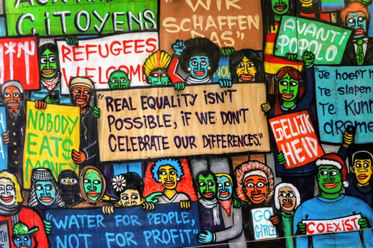
The results of the previous phases using mind mapping and paper prototyping to tease out potential solutions for identified challenges demonstrate that co-design and co-creation engaged participants from inspiration to action.
This methodology let exchanged lessons learned and good practices into multicultural groups.

Slide 24
Mind maps as a visual tool that helps to analyze and structure the information, take participants to recall and generate new ideas.
Enabling migrants to represent concepts without linguistic barriers.

Slide 25
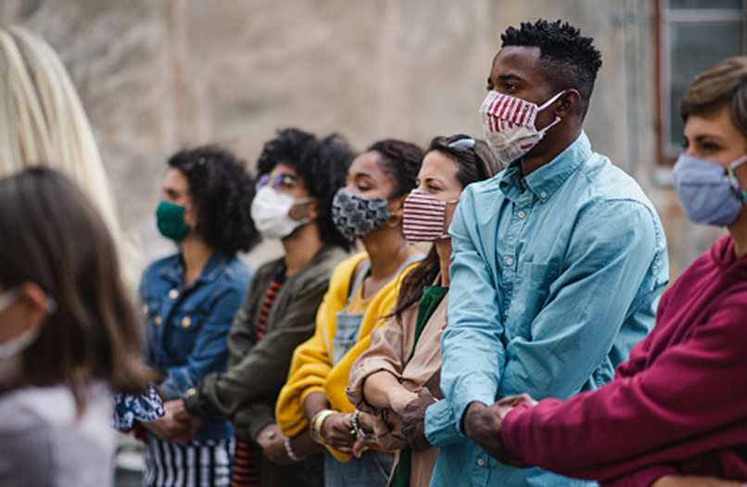
This collaborative methodology helped in allowing migrants who are often victims of abuse to talk more freely and gain control of their situation.
Co-creation empowers the participants to be active in voicing their needs, empowering them to be listened to.

Slide 26
Shared knowledge spaces through discussion groups is very enriching

Slide 27
In these challenging times, a innovative platform as IMMERSE will enable effect management of migrant’s inclusion into the EU labour market by allowing individuals to seek opportunities for skills education or employment

Slide 28
Obstacles such as technology fatigue, gender inequalities, disabilities or special vulnerabilities, shifts in priorities due to pandemics such as COVID-19 or feeling of loneliness testing needs to be take into account in similar future projects

Slide 29
Digital tool needs a human accompaniment to reduce the digital barrier for some people.

Slide 30
Taking into consideration migrant´s opinions in the inclusion of information in the development of technological tools such as IMMERSE was essential

Slide 31
Pre-contact with participants for all the activities
Monitoring participants frequently is needed to ensure motivation and for more in-depth contributions

Slide 32
Testing IMMERSE with real data was a extra motivation factor for migrant´s users and services providers

Slide 33
Questions and Answers
Thank you for your attention!

