Slide 1
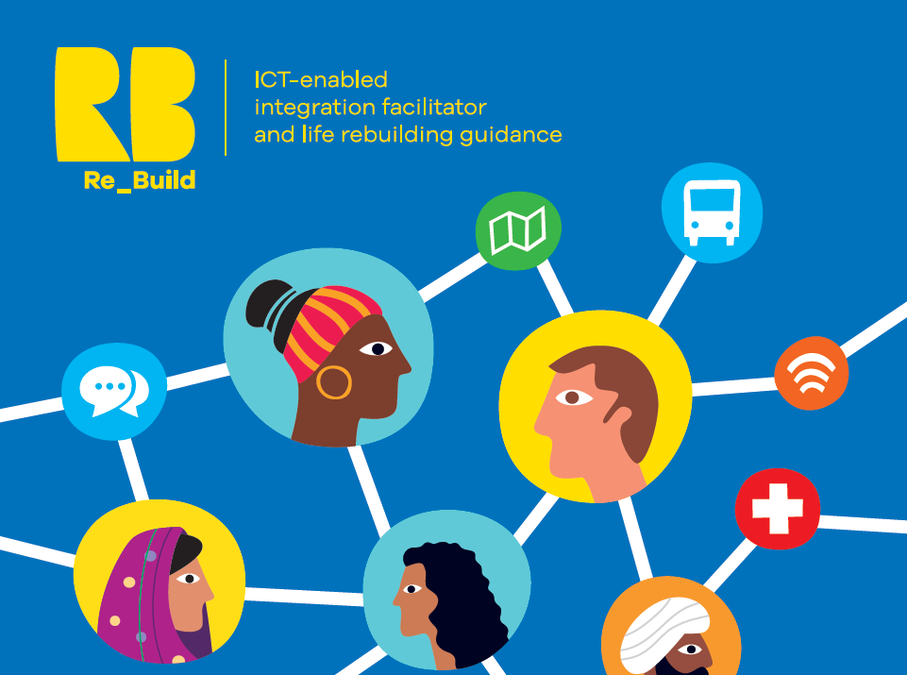
REBUILD Project: Challenges and Impact of Digitalization on Migrants’ Integration
MIICT Project
Final Conference
26/01/2022
www.rebuildeurope.eu
Prof. Maria Amata Garito – REBUILD Project - MIICT Final Conference – 26/01/2022

Slide 2
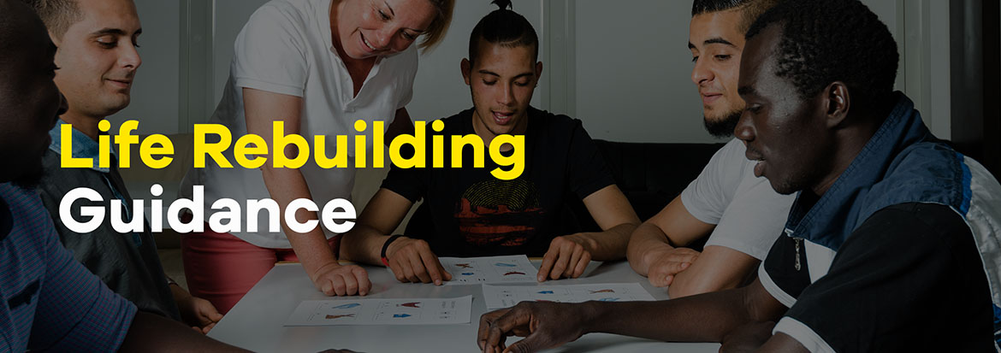
REBUILD Project Objectives
Key technology solutions
GDPR – compliant migrants’ integration
AI-based profile analysis, personalised support and policy making
AI-based needs matching tool
Digital Companion, a personalised two-way communication using chatbots
REBUILD project seeks to address the gap between the supply of public services and the actual possibility of accessing them for refugees and immigrants.
To achieve this, the project is developing and testing an application for refugees and immigrants to assure a better integration in European societies and a more effective matching between their specific needs and the services supply in the hosting countries
Prof. Maria Amata Garito – REBUILD Project - MIICT Final Conference – 26/01/2022

Slide 3
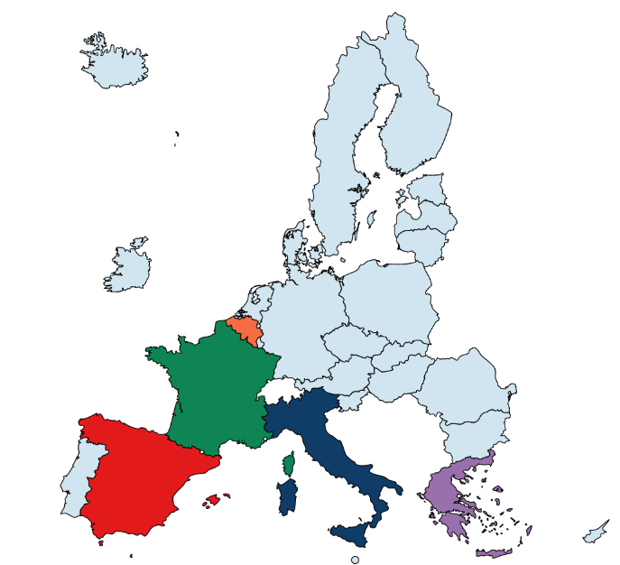










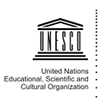
REBUILD Consortium
Italy
Università Telematica Internazionale UNINETTUNO (Coordinator) CIDAS - Cooperativa Sociale di Produzione e Lavoro Engineering Informatica S.p.A.
Greece
CERTH - Centre for Research and Technology Hellas MDAT - Major Development Agency Thessaloniki S.A OMNES - Syllogos Ethelonton Kilkis
Spain
Universidad Politecnica de Madrid Universitat Autonoma de Barcelona
Belgium
Vrije Universiteit Brussel DEN Institute asbl
France / International
United Nations Educational, Scientific and Cultural Organization
Prof. Maria Amata Garito – REBUILD Project - MIICT Final Conference – 26/01/2022

Slide 4
REBUILD: human-centered approach to digital innovation
Multidisciplinary partnership (NGOs, Tech Research Centers, Large Tech Industry, UNESCO, SSH HEIs for service design, ethics and legal aspects) in 3 pilot countries (Italy, Spain, Greece)
Participatory design approach
        - Questionnaires and Interviews designed with migrants and
        refugees researchers and operators
        - Administered to migrants/refugees and to local service providers for gathering actual needs and gaps driving app design and development
        - Focus groups about cultural markers for tech solution design
          Information and data collected and elaborated for Experience Mapping, Service Models and Service Strategies discussed in 3 Co-Creation Workshops in the 3 pilots
Prof. Maria Amata Garito – REBUILD Project - MIICT Final Conference – 26/01/2022

Slide 5
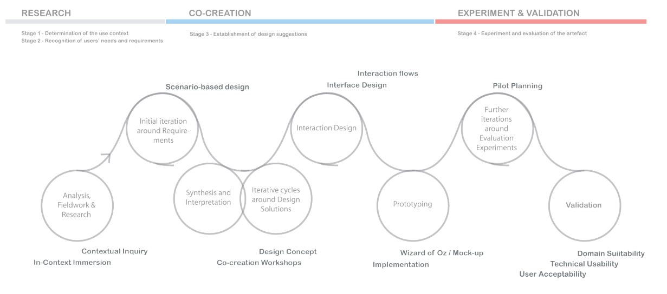
Prof. Maria Amata Garito – REBUILD Project - MIICT Final Conference – 26/01/2022

Slide 6
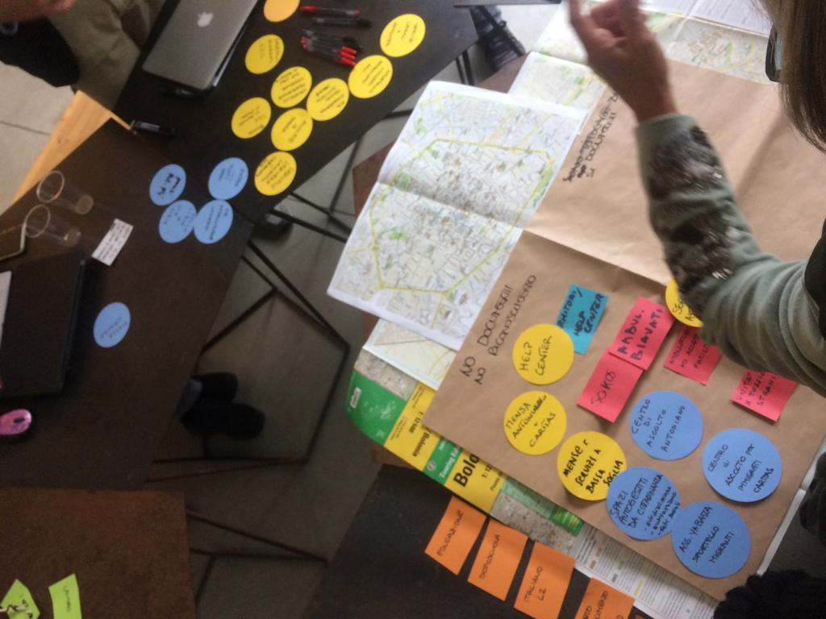
Users involvement and users needs analysis
217 Migrants and 77 Local Services Providers
Background information gathering
Italy 50 participants
Gambia, Nigeria, Mali, Pakistan, Senegal, Ghana, Sudan, Somalia, Cuba, Benin, Bangladesh, Armenia, Libya
Greece 50 participants
Iraq, Syria, Afghanistan, Iran, Palestine, Kurdistan
Spain 49 participants
Venezuela, Syri, Ukraine, Colombia, Nigeria, Senegal, Salvador, Guinea, Gambia, Morocco, Cameroun
Service provision analysis
50 LSPs interviewed
Italy: 7 Local Public Bodies, 2 NGOs, 13 Private
Greece: 8 Local Public Bodies, 7 NGOs, 1 Private
Spain: 5 Local Public Bodies, 6 NGOs, 1 Private
Pilot and validation
100+ users (Migrants, LSPs) already completed the pilot, currently managing additional pilot experiments
Prof. Maria Amata Garito – REBUILD Project - MIICT Final Conference – 26/01/2022

Slide 7
Challenges from the User Research
Migrants’ integration and exclusion
Inadequate knowledge of the language > restrictions on access to information, use of services, expression of needs and limited access to social context
Weak awareness of duties and rights > migrants and refugees miss to know social rules, miss to get opportunities and services > lack of knowledge about the available services at local level
Linguistic, cultural and technological literacy
Language: need for a simplified language, made of visual codes and based on visual grammar, made of pictograms, graphic animations and videos
Culture: acquire and manipulate concepts shared with the rest of the community
Technology: understanding of potential and role of technology, use of ICT features and services
Diverse requirements
Lack of uniformity in user requirements: diverse needs, abilities and limitations and thus diverse interaction strategies: from natural language processing to purely visual language
Migrants’ personal perspectives and expectations in regaining autonomy and reconstruction of life experience
Prof. Maria Amata Garito – REBUILD Project - MIICT Final Conference – 26/01/2022

Slide 8
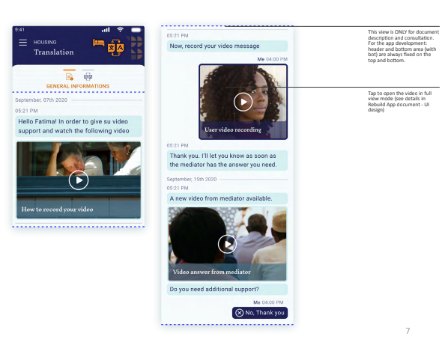
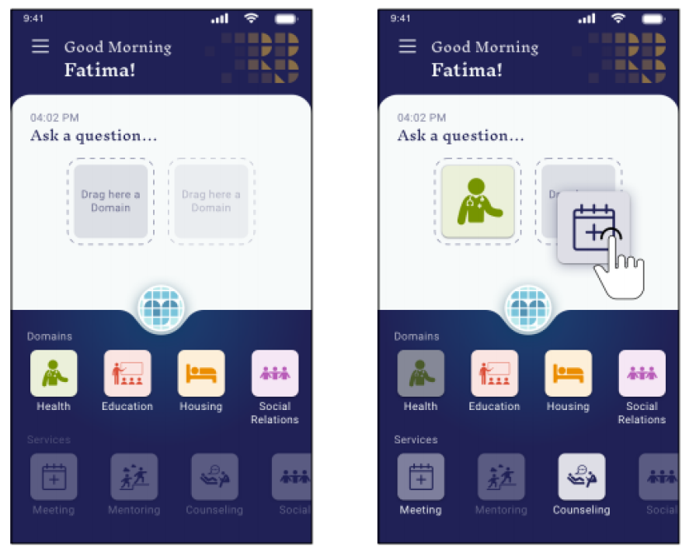
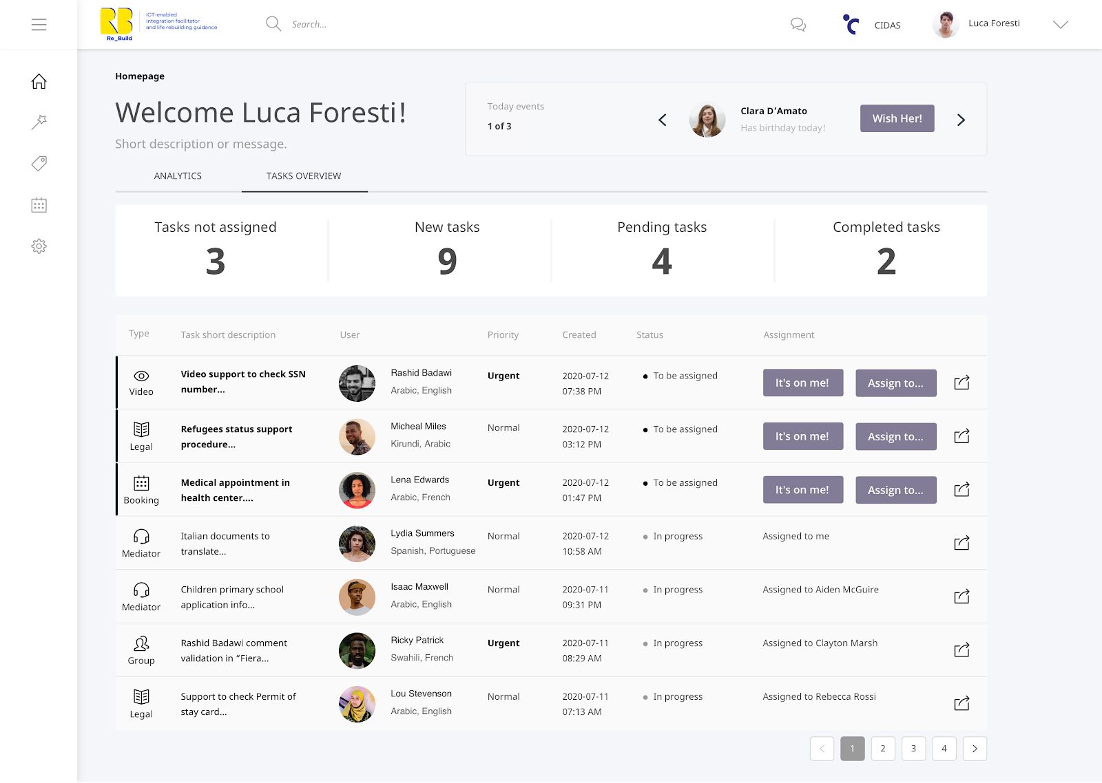
REBUILD Solution
Multi-language mobile app
Video and animation introducing the features
Visual-supported 2 way communication (Pictograms)
Rule-based conversation trees (communication fully under control)
Multilanguage w/ automatic translation CMS for Local Service Providers
Integrated diachronic A/V communication tool
Match-making tool: User profiling, LSP catalogue and recommender systems interacting for:
                Cross-domain interactions
                Proactive suggestions
Prof. Maria Amata Garito – REBUILD Project - MIICT Final Conference – 26/01/2022

Slide 9
Impact and open questions
Scalability
maximizing adoptability across service provision models
Accessibility
augmented pictograms for multi-modal communication
Research-driven design
involving more EU regions in the process
Data-based sustainability
proven cost-effectiveness for attracting local PAs and LSPs
Prof. Maria Amata Garito – REBUILD Project - MIICT Final Conference – 26/01/2022

Slide 10
Thank you!
rebuild@uninettunouniversity.net
www.rebuildeurope.eu
Prof. Maria Amata Garito – REBUILD Project - MIICT Final Conference – 26/01/2022

