Slide 1
Policy recommendations from the MIICT project
Final MIICT Conference, 26th, January 2022
Theoni Spathi - CERTH

Slide 2
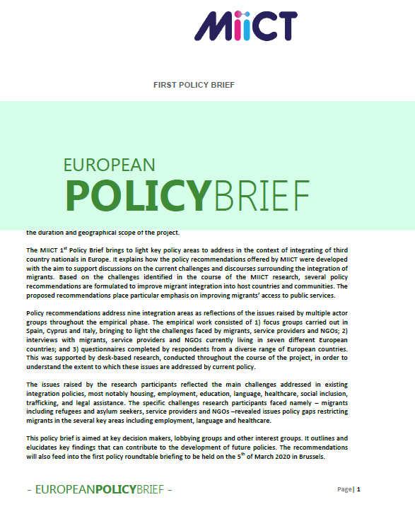
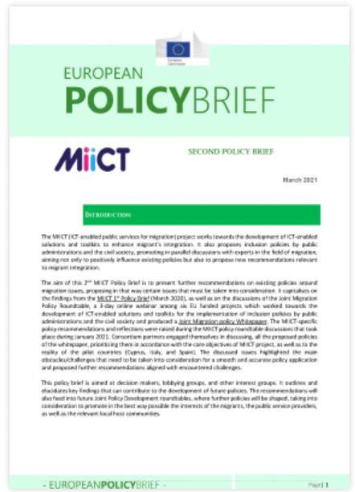
Policy Recommendations Roadmap
First policy Brief
Desk-based research along with discussions in pilot countries (FGD)
April October 2019
March 2020
Desk-based research along internal meetings and discussions
14-16 October 2020
1st Joint Migration Policy Roundtable
January-February 2021
Second policy brief
March 2021
2nd Joint Migration Policy Roundtable
Final policy Recommendations “joint handbook on migrants' integration: a service design and supply perspective” in preparation
22-23 October 2021
January 2022
Notes:
Cover core thematic pillars of the MIICT project (employment, social inclusion, legal issues, housing, health, education, human trafficking and ICT)
Key documents of the analysis included the 2004 EU Common Basic Principles for Immigrant Policy, the 2015 European Agenda on Migration, and the 2016 European Commission Action Plan on the integration of third country nationals
The comparative analysis aims at providing a comprehensive picture of the chronological development of EU migrant integration policy, in light of the changing migration context in the Union
Then they were cross-analysed with insights from the empirical research in Spain, Cyprus, and Italy
44 general policy recommendations have been developed; additionally, 16 country-specific recommendations have been developed

Slide 3
9 challenges (pillars) for migrant integration
Status
Language
Education
Accommodation (Housing)
Employment
Social Security
Co-Creation and Participatory Design
Multi-stakeholder collaboration
Transportation (Mobility)
Health
Social Integration
ICT tools and digital services for supporting integration recommended to the European Commission

Slide 4
Co-Creation and Participatory Design
Understand migrants’ and refugees’ life as a prerequisite for participation.
Address specific issues and challenges in a wider perspective.
Recognize the necessity of co-design for trust building.
Push ahead participatory design and community-based approach (customized and individualized to personalized services and needs)
Pilot the culture of co-design as an internal cultural change in public administrations
Encourage active participation through introducing certain incentives for all possible stakeholders, strengthening synergies and producing easily to integrate systems

Slide 5
Multi-stakeholder collaboration
Capitalize on cooperation and coordination among stakeholders, focusing on organisational engagement rather than on individual participation.
Encourage a multi-stakeholder approach.
Work towards the delivery of digital services to migrants and refugees
Promote Funding and Sustainability
Focus on the migration topic
Capitalize on success stories for migration reception and integration.
Adopt a multi-stakeholder integration process
Bring forward the active participation of migrant representatives and local communities and citizens from diverse backgrounds to better influence decision-making.

Slide 6
ICT tools and digital services for supporting integration recommended to the European Commission
Promote digital transformation, digital education and infrastructure, assessing future integration policies
Enhance literacy (linguistic, digital, and cultural) as well as integration of diverse requirements via mandatory technological digital training courses
Focus on the way existing technological solutions (e.g., translation services etc.) could evolve to support multi-faceted ICT solutions that respect cultural diversity among end users.
Rights-Based Approach: Facilitate the design and incorporation of technologies that enhance human rights, including legal implications related to human rights infringement
Implementation of data protection by default and by design in all ICT platforms
Protection of personal data mechanisms and adequate and effective remedies in cases of breaches ought to be established with a particular emphasis on vulnerable groups
Encourage Innovation, research, and development.
Capitalise on the momentum of digitization of public services related to COVID-19 pandemic and invest further in digital transformation and relevant targeted training to certain stakeholders with a governmental background.
Capitalize on funding and sustainability issues related to ICT proposed solutions, where EC can play a pivotal role of support.

Slide 7
Main MIICT themes
ACCESSIBILITY
CREDIBILITY
RELIABILITY

Slide 8
Questions and Answers
Q & A

Slide 9
Thank you

