Slide 1
ICT Enabled Public Services for Migration
Measuring the Impacts of MIICT
Tuomas Tammilehto (Laurea University of Applied Sciences, Finland)

Slide 2
What is an impact?
”Influence of an action and/or phenomenon on something or someone.”
Government policies, different services, businesses, infrastructure…
Influences
The Society:
Individuals: education, health, income & wealth, occupation, living standards, accommodation, self-fulfilment, liberties…
Organisations: performance, competitiveness, opportunities, reputation, supply, assets, resources, work force, service…
Country/society: politics, national wealth, product & growth, labour market, national resources, governmental service level…
Generate
ICT (incl. Internet, mobile network, Wi-Fi, Hardware, Software, Computing…)
The MIICT services / solutions
Enable
Impact
Support
Human capital
Social capital
Determines

Slide 3
The impact areas of IMMERSE (1/2)

Slide 4
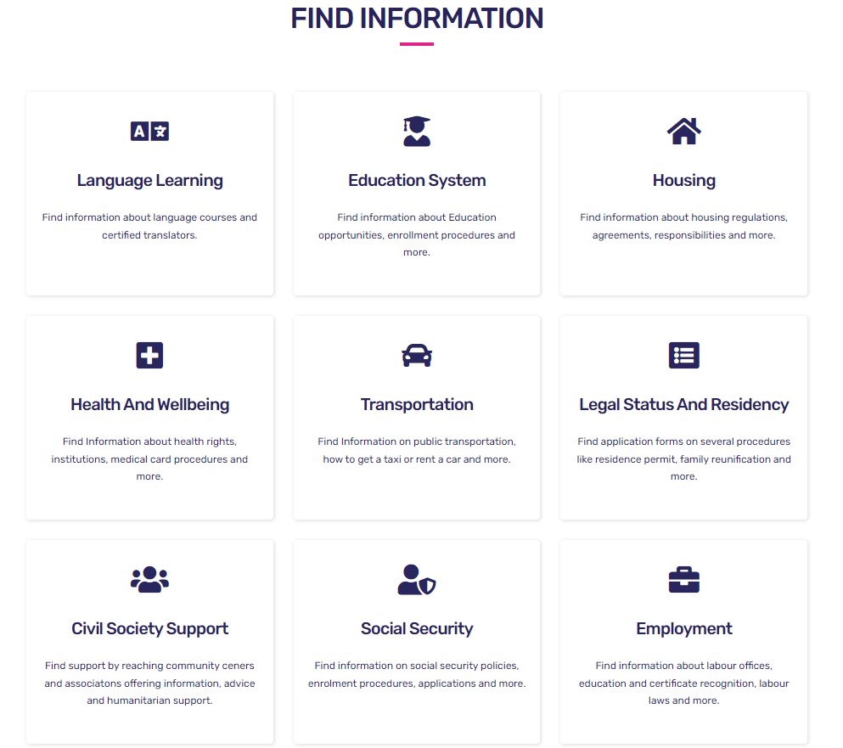
The impact areas of IMMERSE (2/2)

Slide 5
The desired impact of MIICT:
Employment
Accommodation
Health
Social integration
Social security (often synonym with social welfare)
Employment
Language
Transportation, and
Status

Slide 6
How to measure?
Using questionnaires that were done during the SSD phase
Based on the migrants’ and service providers’ answers on needs, appreciation, and expectations
“Gestimation” = between a guess and an estimation

Slide 7
Italy
Employment
Overall, employment in one of the most needed area of life that would increase the wellbeing of immigrants, and also the society. This was highlighted in the migrants answers, as well as in the “wish list” of the SPs.
Employment is especially important for the former minors, since getting the first job is usually the thing that opens for further opportunities.
The unemployment rates of young minors are high, so this ameliorating this would benefit greatly the society too.
Accommodation
Housing is a fundamental need, and any attempts to ameliorate the housing market for migrants would have a positive impact on the migrants’ lives, but also helping integrating to the society.
Especially finding accommodation for the migrants needs enhancements, and in this IMMERSE has potential. However, many of the currently existing practicalities in place in Italy inhibit the use of many online platforms, thus limits the impact of IMMERSE
Social integration
IMMERSE would have an impact on this area, since the services, such as, finding training and interacting with locals and SPs are important, however, based on the responses the impact can be moderate.
Language
Language was one of the most sought impact of IMMERSE from SPs point-of-view. Learning the language would help in so many areas of life. The migrants too valued the various training courses, language courses included. Taking into account the importance on language, IMMERSE would make another big impact: offering services in the migrants languages too. This would, e.g., ease communication between migrants and SPs, thus possibly ameliorate every interaction.
Transportation
This area was raised by some respondents, and it indicated that IMMERSE could have the potential of delivering information on transport to the migrants. This could increase the movement of the migrants, perhaps, they could search for employment, education, courses etc. from a wider geographical area, once they know how the public transportation works.

Slide 8
Cyprus
Employment
The impact would be highly valued, although it was not possible to really measure that, since the services of employment were not in use in the Cypriot version of IMMERSE
Overall, employment in one of the most needed area of life that would increase the wellbeing of immigrants, and also the society.
Most of the destination countries are failing to utilise much of the potential that immigrants offer. This would have a huge impact on societies, especially with the aging populations.
Accommodation
Housing is a fundamental need, and any attempts to ameliorate the housing market for migrants would have a big positive impact on the migrants’ lives, but also helping integrating to the society. The ultimate cases of migrants living on the streets not only impedes integration, but often results to even greater marginalisation.
Social integration
IMMERSE would have a significant impact on this area, since the services, such as, finding training and interacting with locals and SPs very highly rated and seen very important.
Language
Language was one of the most sought impact of IMMERSE from SPs point-of-view. Learning Greek would help in so many areas of life. The migrants too valued the various training courses, language courses included. Taking into account the importance on language, IMMERSE would make another big impact: offering services in the migrants’ languages too. This would, e.g., ease communication between migrants and SPs, thus possibly ameliorate every interaction.

Slide 9
Spain
Employment
Being employed was one of the most valued areas of life, but also something that IMMERSE could have a huge impact. The employment of migrants would naturally benefit the migrants financially, helping in integrating to the society, but also benefit the Spanish/Andalusian society.
Accommodation
Housing is was raised as one of the most important areas of life. Impact, even a small one would therefore have big consequences in the lives of immigrants. this was not measured in the Spanish questionnaire, however, the IMMERSE could make a significant impact in migrant housing market.
The ultimate cases of migrants living on the streets not only impedes integration, but often results to even greater marginalisation.
Social integration
IMMERSE would have a significant impact on this area, since the services, such as, finding training and interacting with locals and SPs very highly rated and seen very important.
Social integration is related with others too, e.g., language and jobs, housing etc. thus IMMERSE could have a big impact in this.
Language
Language was high on the list of both SPs (2nd) and migrants (4th), and thus could have a big impact on migrants’ lives. It is evident that knowing the language of a new country eases the integration. Although it must be highlighted that many of the migrants in Spain comes from Spanish speaking countries.
Enhanced language capabilities is not only for the migrants, but for the SPs too. The communication and the ability to search for information, for examples, are very important in life.

Slide 10
Other impacts
Policy papers, ethics, knowledge, interaction, dissemination…

Slide 11
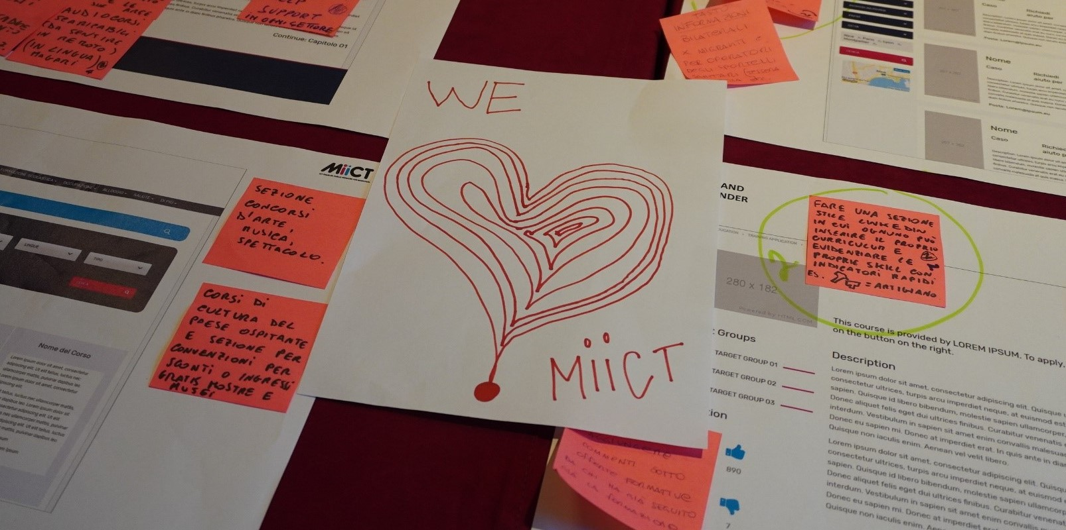
Thank you for your attention!

