Slide 1
ICT Enabled Public Services for Migration
Babak Akhgar (CENTRIC)
Co-creating ICT enabled public services for migration: challenges, solutions and sustainability
26th January 2022 Final conference for the H2020 MIICT project

Slide 2
The MIICT Consortium
CENTRIC | Centre of Excellence in Terrorism, Resilience, Intelligence and Organised Crime Research, Sheffield Hallam University
SYNYO | SYNYO GmBH
KEMEA | Center For Security Studies Centre D’etudes De Securite
LAUREA | Laurea University Of Applied Sciences
LIF | Law And Internet Foundation
ADITESS | Advanced Integrated Technology Solutions And Services Ltd
CERTH | Centre For Research And Technology Hellas Certh
AGENFOR | Agenfor International
EUROTHINK | Association of Citizens for Research, Analysis and Public Policy Development
FUNDEA. | Fundaction Euroarabe De Altos Estudios
CSD. | Centre for the study of Democracy
ALDA. | Association Des Agences De La Democratie Locale
CARITAS. | Koinonia Caritas Cyprus
ENGOMI. | Municipality Of Engomi

Slide 3
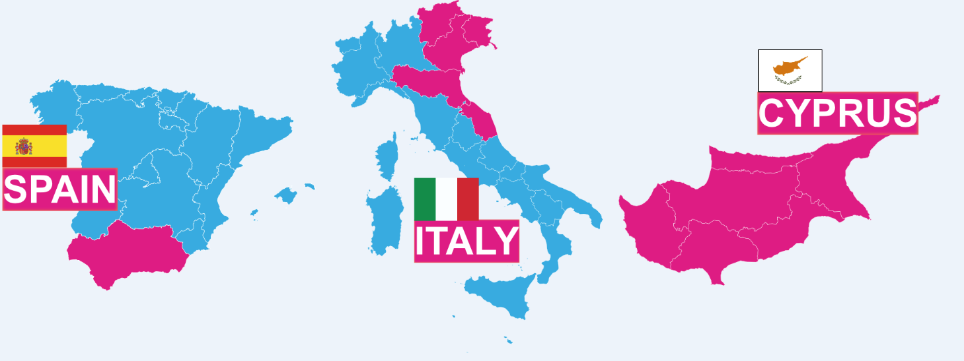
Pilot locations
Notes:
SPAIN:
Andalusia is a large autonomous region in southern Spain incorporating a number of large cities including Seville, Malaga, Cordoba and Grenada.
Out of a population of 8.4 million people the region currently has a foreign-born population of almost 600,000 representing just over 7%.
Of this population an estimated 22% are Moroccan (who are often employed in the agricultural sector as berry pickers), 14% from Romania and 13% from Latin America. T
This represents a particularly diverse migrant population from a range of differing cultures.
Of particular interest is the equality in the gender balance within this foreign-born population.
With respect to migration, FUNDEA already collaborates with a number of non-profits alongside these organisations who interact with all kinds of migrant populations.
ITALY
The Italian pilot is conducted by the Italian Ministry of Justice (MoJ-IT) assisted by Agenfor International using a range of stakeholders involved in the management of immigration from a social, security and legal perspectives of migration.
The selected geographical area covers five regions in the north of the country: Veneto, Trentino Alto Adige, Friuli Venezia Giulia, Emilia-Romagna and Marche.
These regions have a number of centres centres that provide access to migrants at different stages in their immigration journeys for MIICT.
Furthermore, the MoJ-IT provides MIICT with access to the national police, regional governments, municipalities, welfare services, NGOs and volunteers, and the work of the Labour Inspectors by the employment centres (responsible for the fight against illegal exploitation of the migrants).
The majority of these agencies do not employ joined up ICTs in their respective organisations and thus have a clear and identifiable need for the MIICT solutions.
CYPRUS
Nicosia is the largest city on the Island of Cyprus.
Within Nicosia the municipality of Engomi is one of the largest and most progressive local authorities in Cyprus, supporting youth integration and participation of the local citizens in its day to day activities.
ENGOMI has been involved in the integration of migrants
by (1) providing social support and orientation services;
(2) creating opportunities for participation in community, cultural, and sporting events;
(3) facilitating collaboration between associations and informal groups of TCNs with local authorities’ agencies and other local organisations.
CARITAS Cyprus is a member of CARITAS Internationalis and provides critical services to hundreds of migrants and refugees through two centres serving as resource and information hubs for migrants in need of support.
CARITAS Cyprus also operates two shelters for vulnerable migrants and wraparound case management services.
In Nicosia and Larnaca, CARITAS Cyprus’ Migrant Centres are open weekdays to provide a place for migrants to socialize, access legal, healthcare, and psycho-social support, to learn languages and, if necessary, food, clothing and other humanitarian services. In Paphos, the Learning Refuge offers a safe place for families to meet and play, provides language training and other activities.
Currently the municipality of Engomi (ENGOMI) and CARITAS Cyprus (CARITAS) provide migrant with ad-hoc support that lacks a combined platform where supporting and beneficial actions are recorded. This means support can be duplicated or even omitted and time, energy and resource are not being used efficiently.
MIICT aims to make the most of CARITAS's access to migrants through these hubs by providing MIICT services, such as IMMERSE, within these hubs meaning MIICT is deployed in locations they already access rather than attempting to change behavioural patterns.

Slide 4
The MIICT CSF
MIICT is developed , designed and deployed with the end user at its core
We are grateful for the dedication of our partners in our pilot locations

Slide 5
MIICT- Project Results
In the MIICT (ICT Enabled Public Services for Migration) H2020 project, researchers have co-designed and co-developed an interactive platform called IMMERSE with migrants, asylum seekers, refugees, and representatives from NGOs (Non-Governmental-Organisations), public authorities and other interest groups
The methodology of co-creation empowered migrants, enabling them to design the platform with stakeholders that normally make decisions for them
This bottom-up strategy enabled researchers in the MIICT project to create a platform that responds to the real needs of migrants, asylum seekers and refugees

Slide 6
MIICT- Project Results
The Immerse platform offers customised access to key public services in a one-stop-stop design, enabling migrants to be independent and proactive in their migration journeys
It allows them to get access to crucial, frontline services including health, education and training, housing, and legal information
The platform aids migrant integration by providing a job and skills matching decision support tool thereby reducing the discrimination that migrants may face when trying to find a job
Migrants were further able to test the usability of the platform in an extensive sustained delivery phase for 6 months

Slide 7
MIICT- project results
The platform provides information in multiple languages, enabling migrants to create their own CV, get access to interactive maps and even register to become a volunteer
It provides both Transactional and informational services
The platform is inclusive and videos are incorporated onto the platform to ensure all users can engage with it
The legal team have also integrated ethical and privacy protocols to ensure that migrants’ data protection rights are protected

Slide 8
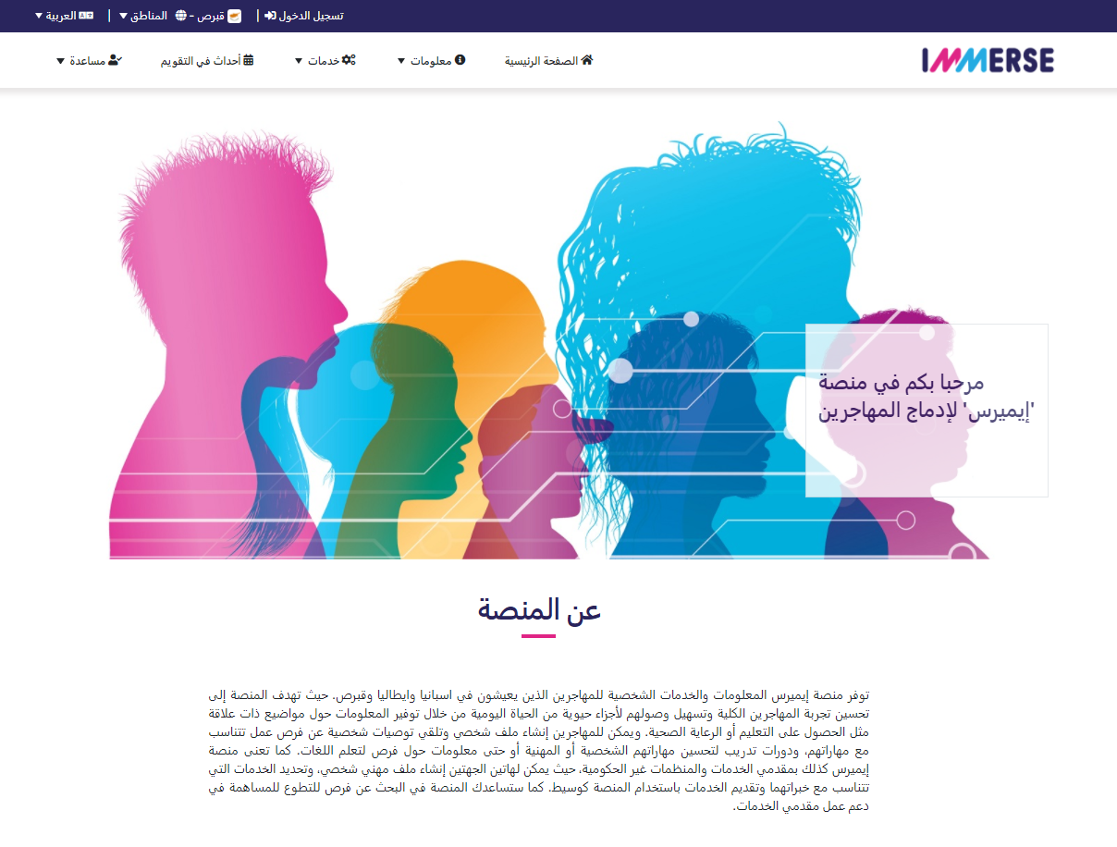
IMMERSE Platform Languages (English, Spanish, Greek, Italian, French, Arabic)

Slide 9
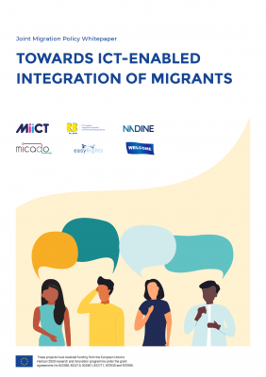
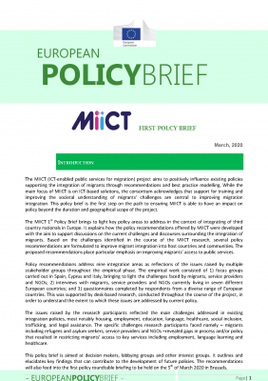
Research Outputs
The research has impacted policy at the EC level through its joint policy roundtables with the sister projects and subsequent whitepaper and policy briefs
Researchers have translated these briefs into the local languages in the pilot counties to ensure national, regional and local policy makers are reached
Partners have also created several handbooks, including an inclusivity handbook and a co-design for public transformation handbook which will help researchers by providing a list of best practices and pitfalls. These will be made public on our website www.miict.eu

Slide 10
Edited Volume - Springer
We have reported our research in an edited volume
Akhgar, B., Hough., K.L., Abdel-Samad, A., Bayerl., S & Karakostas, T. (Eds) (2022) Information and Communications Technology in Support of Migration. Springer: Geneva: Switzerland.
The book contains 22 Chapters with contributions from nine projects funded in the prestigious European Horizon 2020 programme
It presents a multi-disciplinary, international and evidence-based approach to migration, with contributions from technological developers, engineers, academics, practitioners, lawyers and computer scientists

Slide 11
MIICT
Thank you

